Slide 1
Integration of multi-omics data in yeast
Shuang Li
Samuel Ramirez
Matthew Berginski
Yue Hu
Elton Rexhepaj

Slide 2
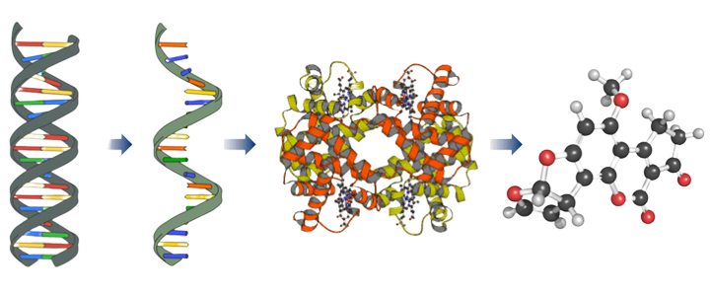
Genomics
Transcriptomics
Proteomics
Metabolomics
21609
49714
46255
19942
https://images.app.goo.gl/2Mcgdrc5Hpa8LN8C6

Slide 3
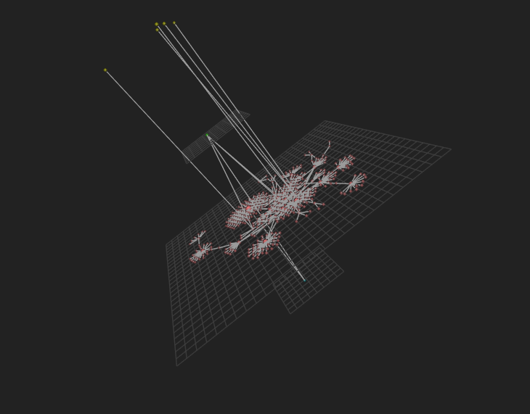
Images produced by OmicsNet

Slide 4
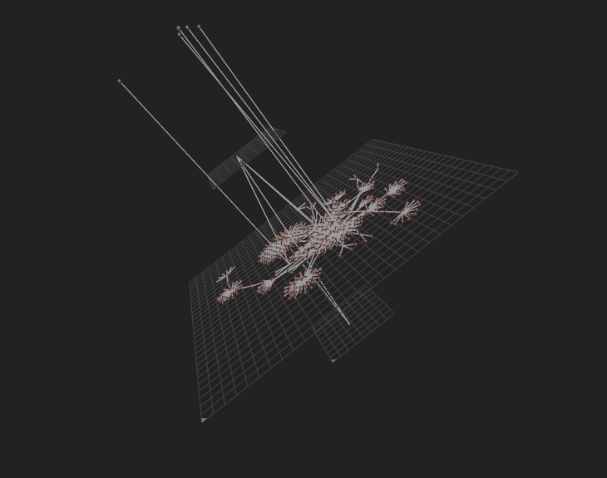
Images produced by OmicsNet

Slide 5
Genomics
Transcriptomics
Proteomics
Metabolomics
gene
gene
metabolite
https://images.app.goo.gl/2Mcgdrc5Hpa8LN8C6

Slide 6
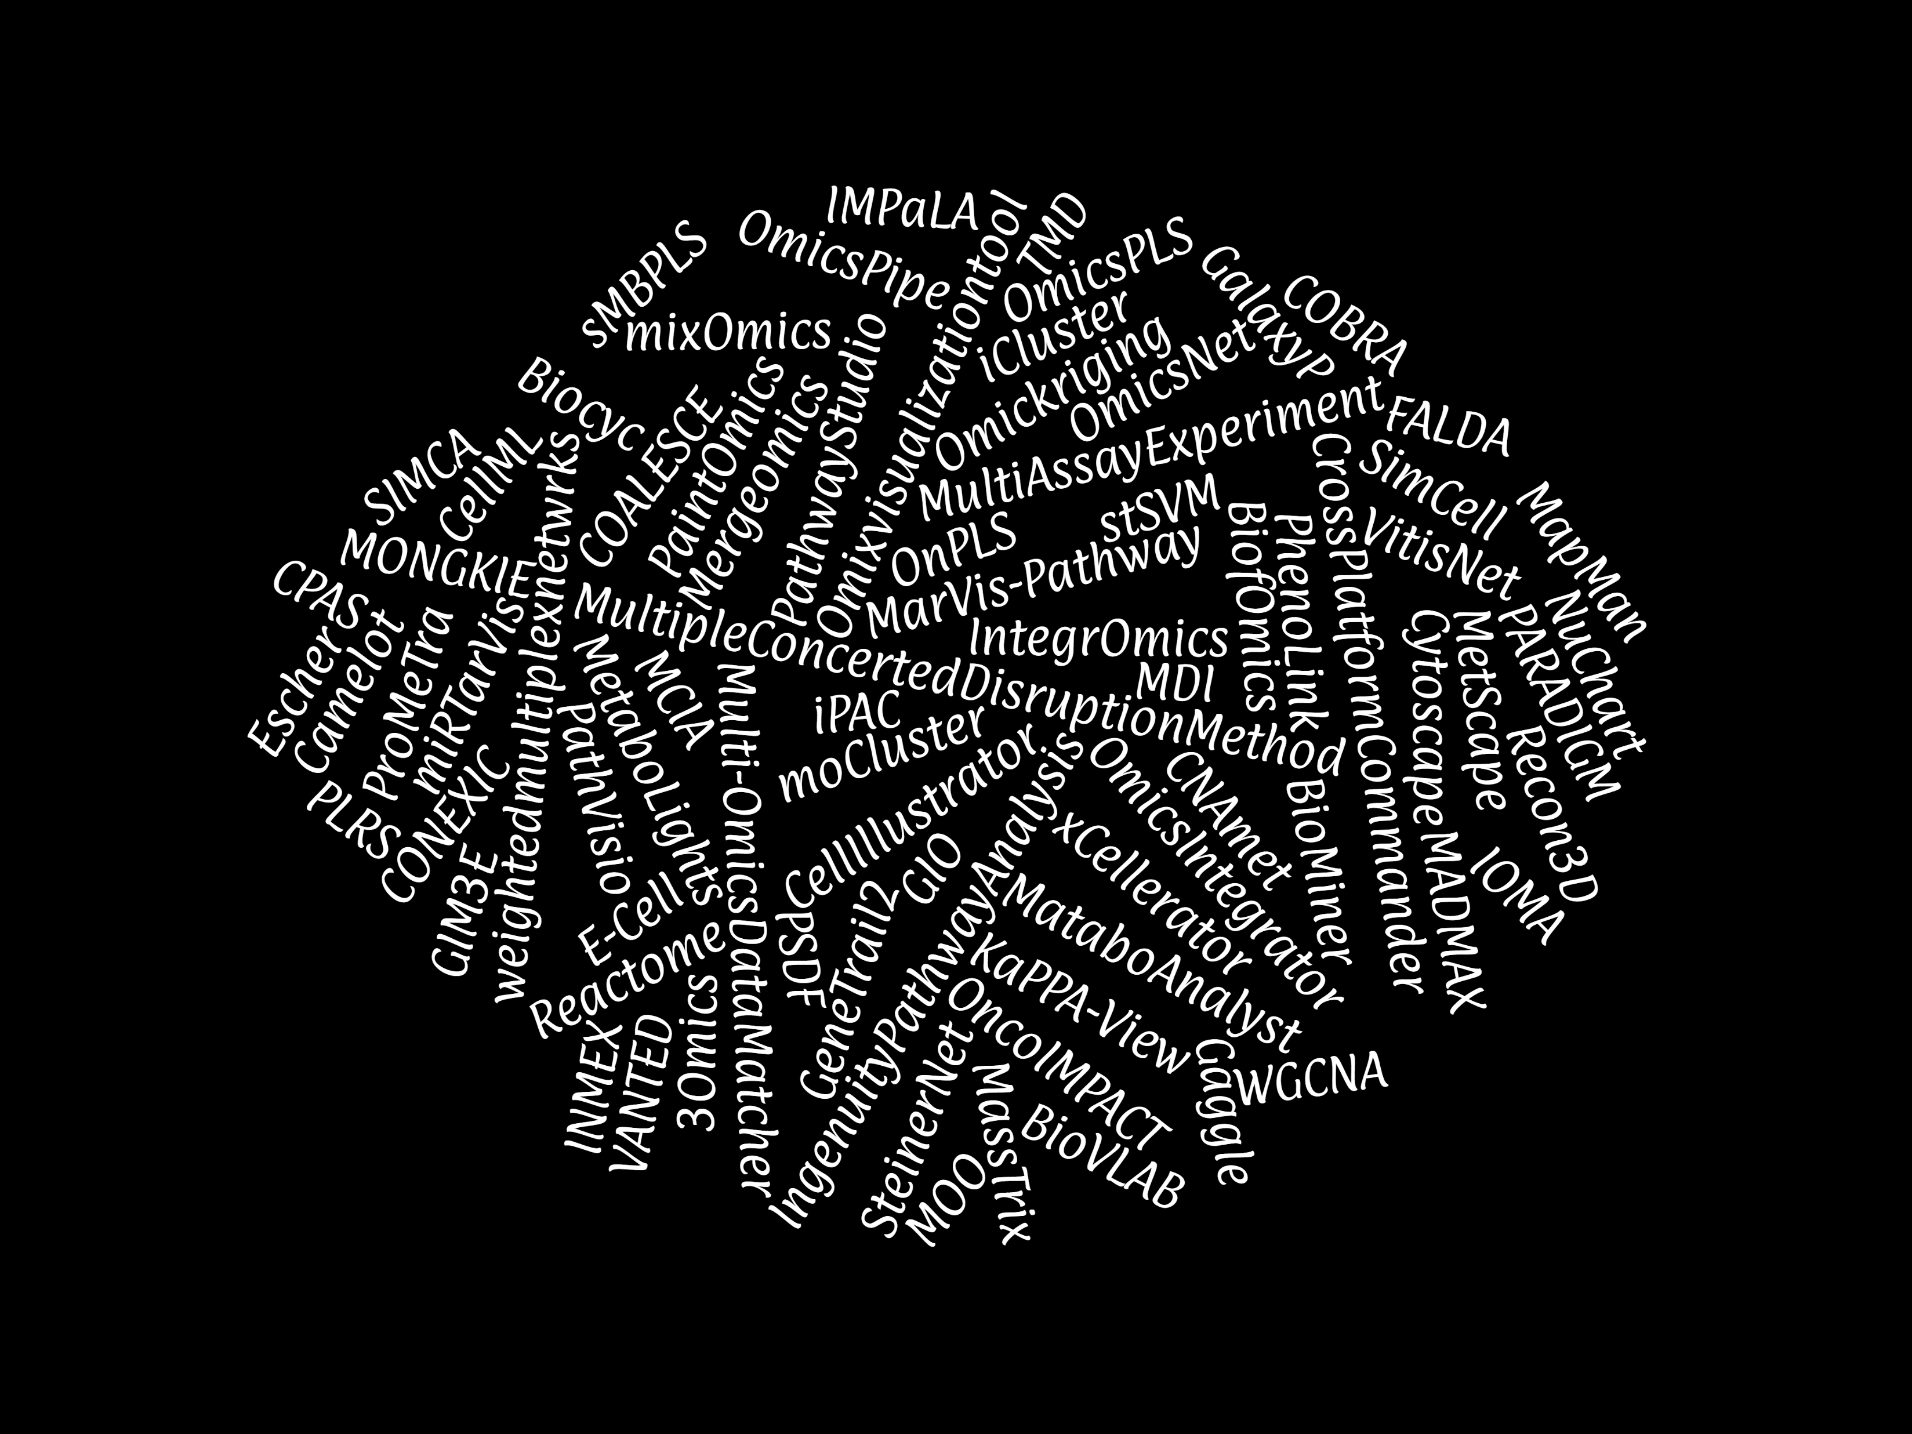

Slide 7
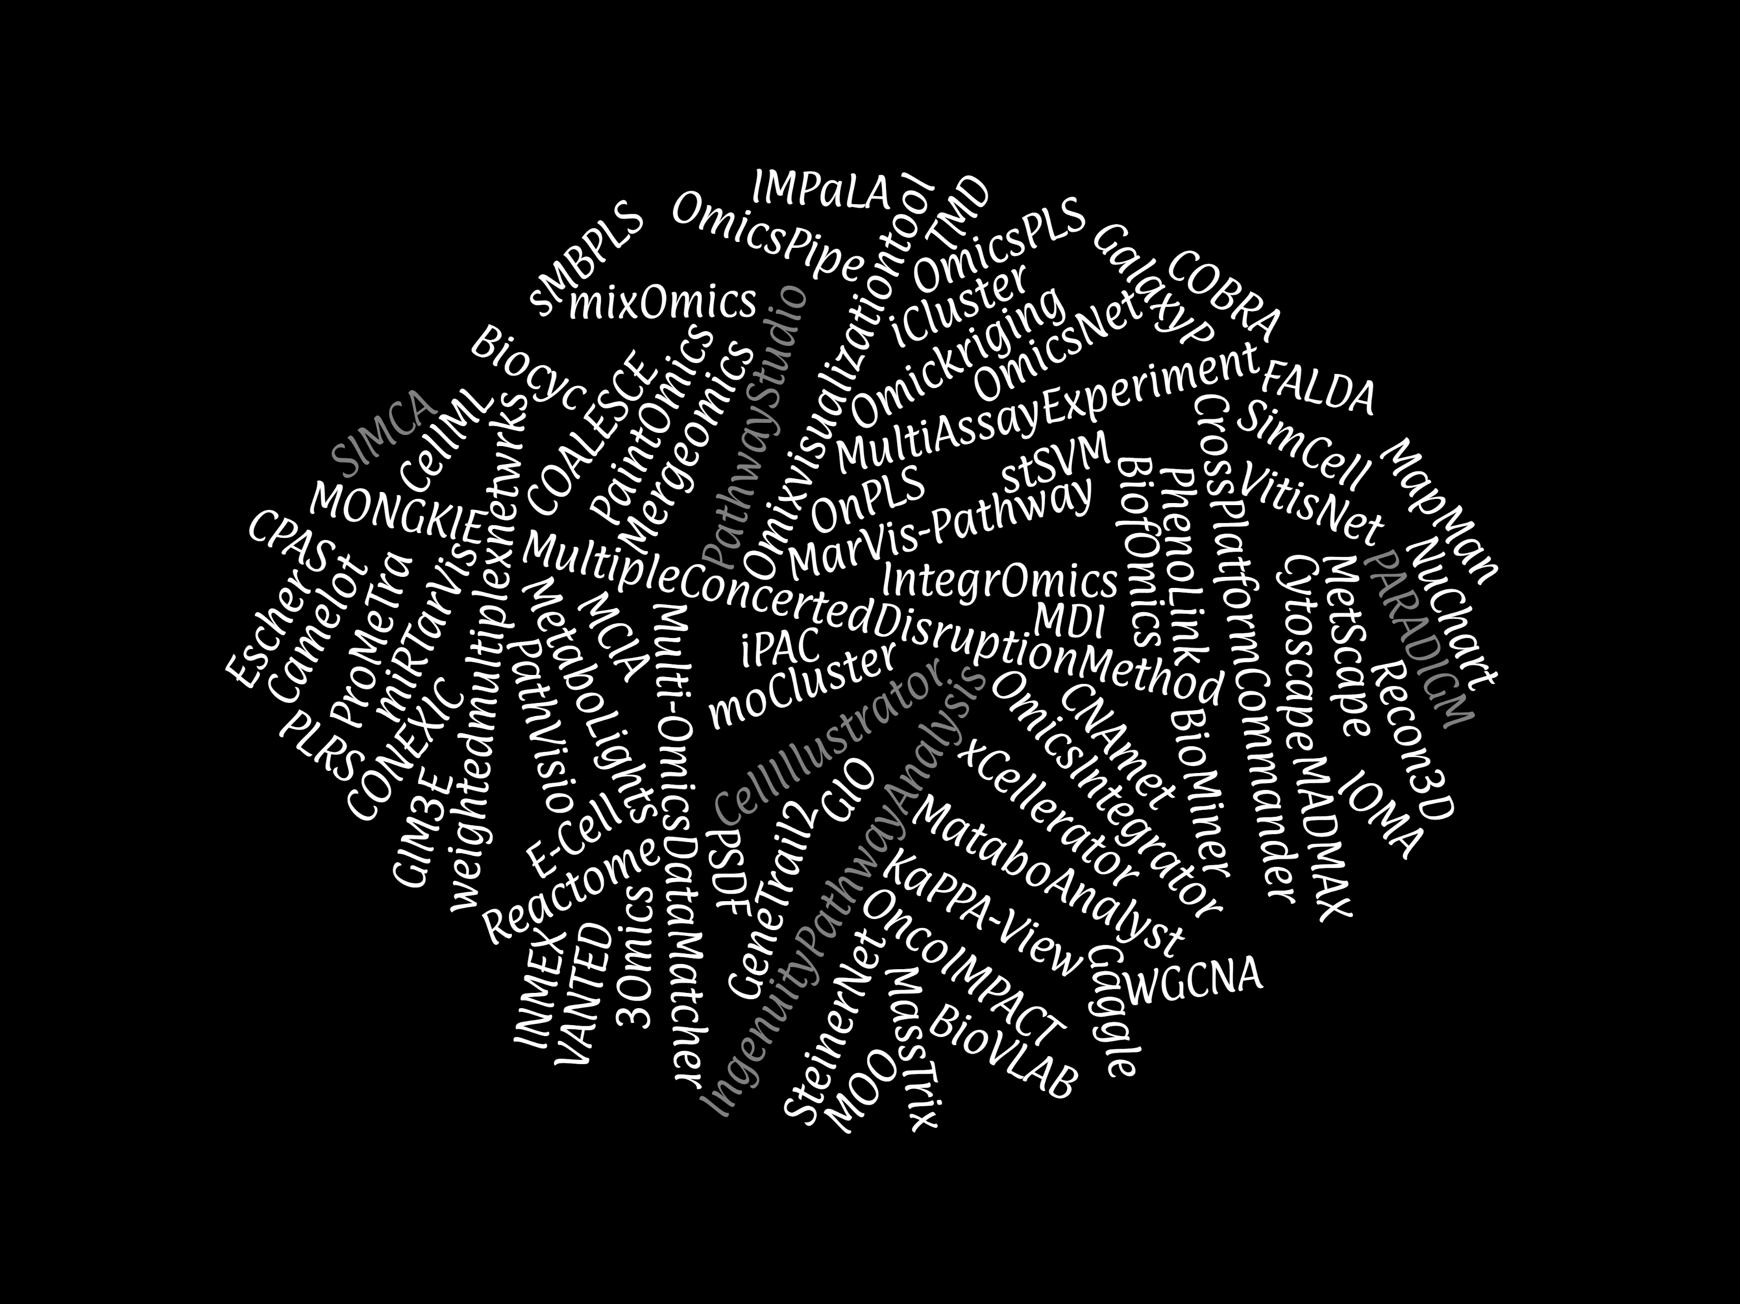

Slide 8
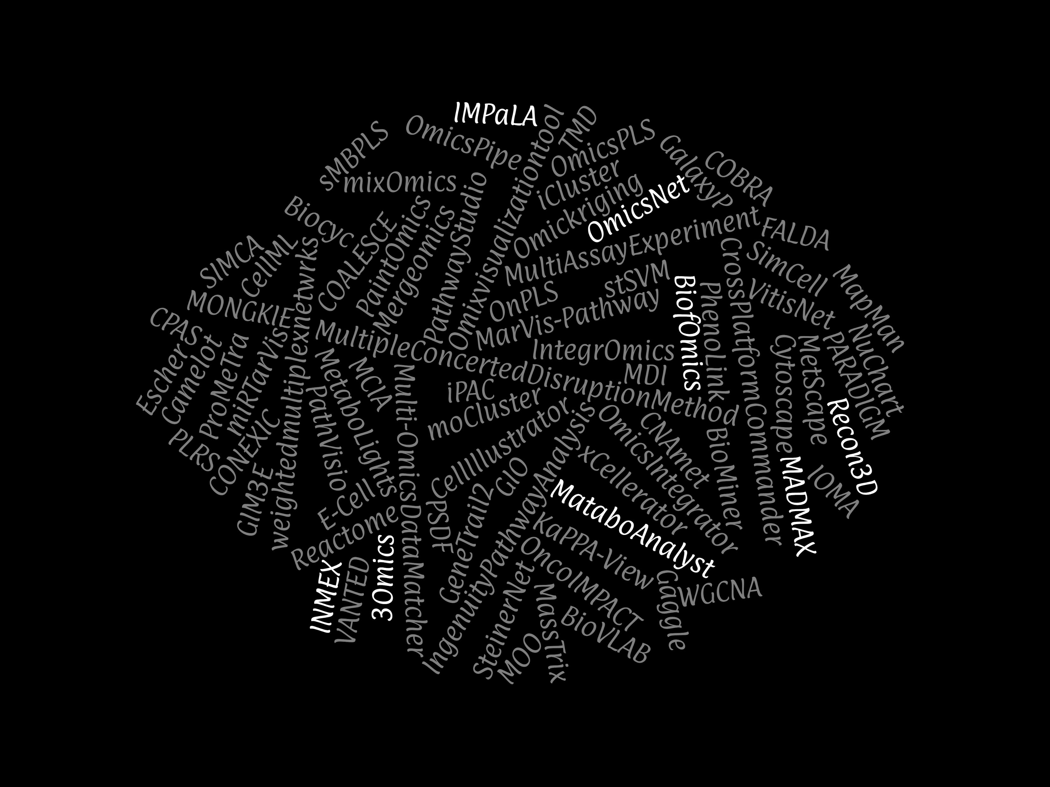

Slide 9
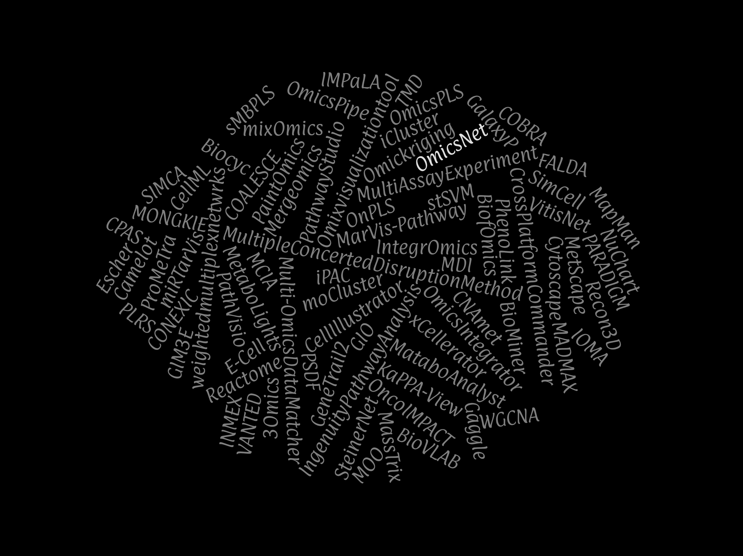

Slide 10
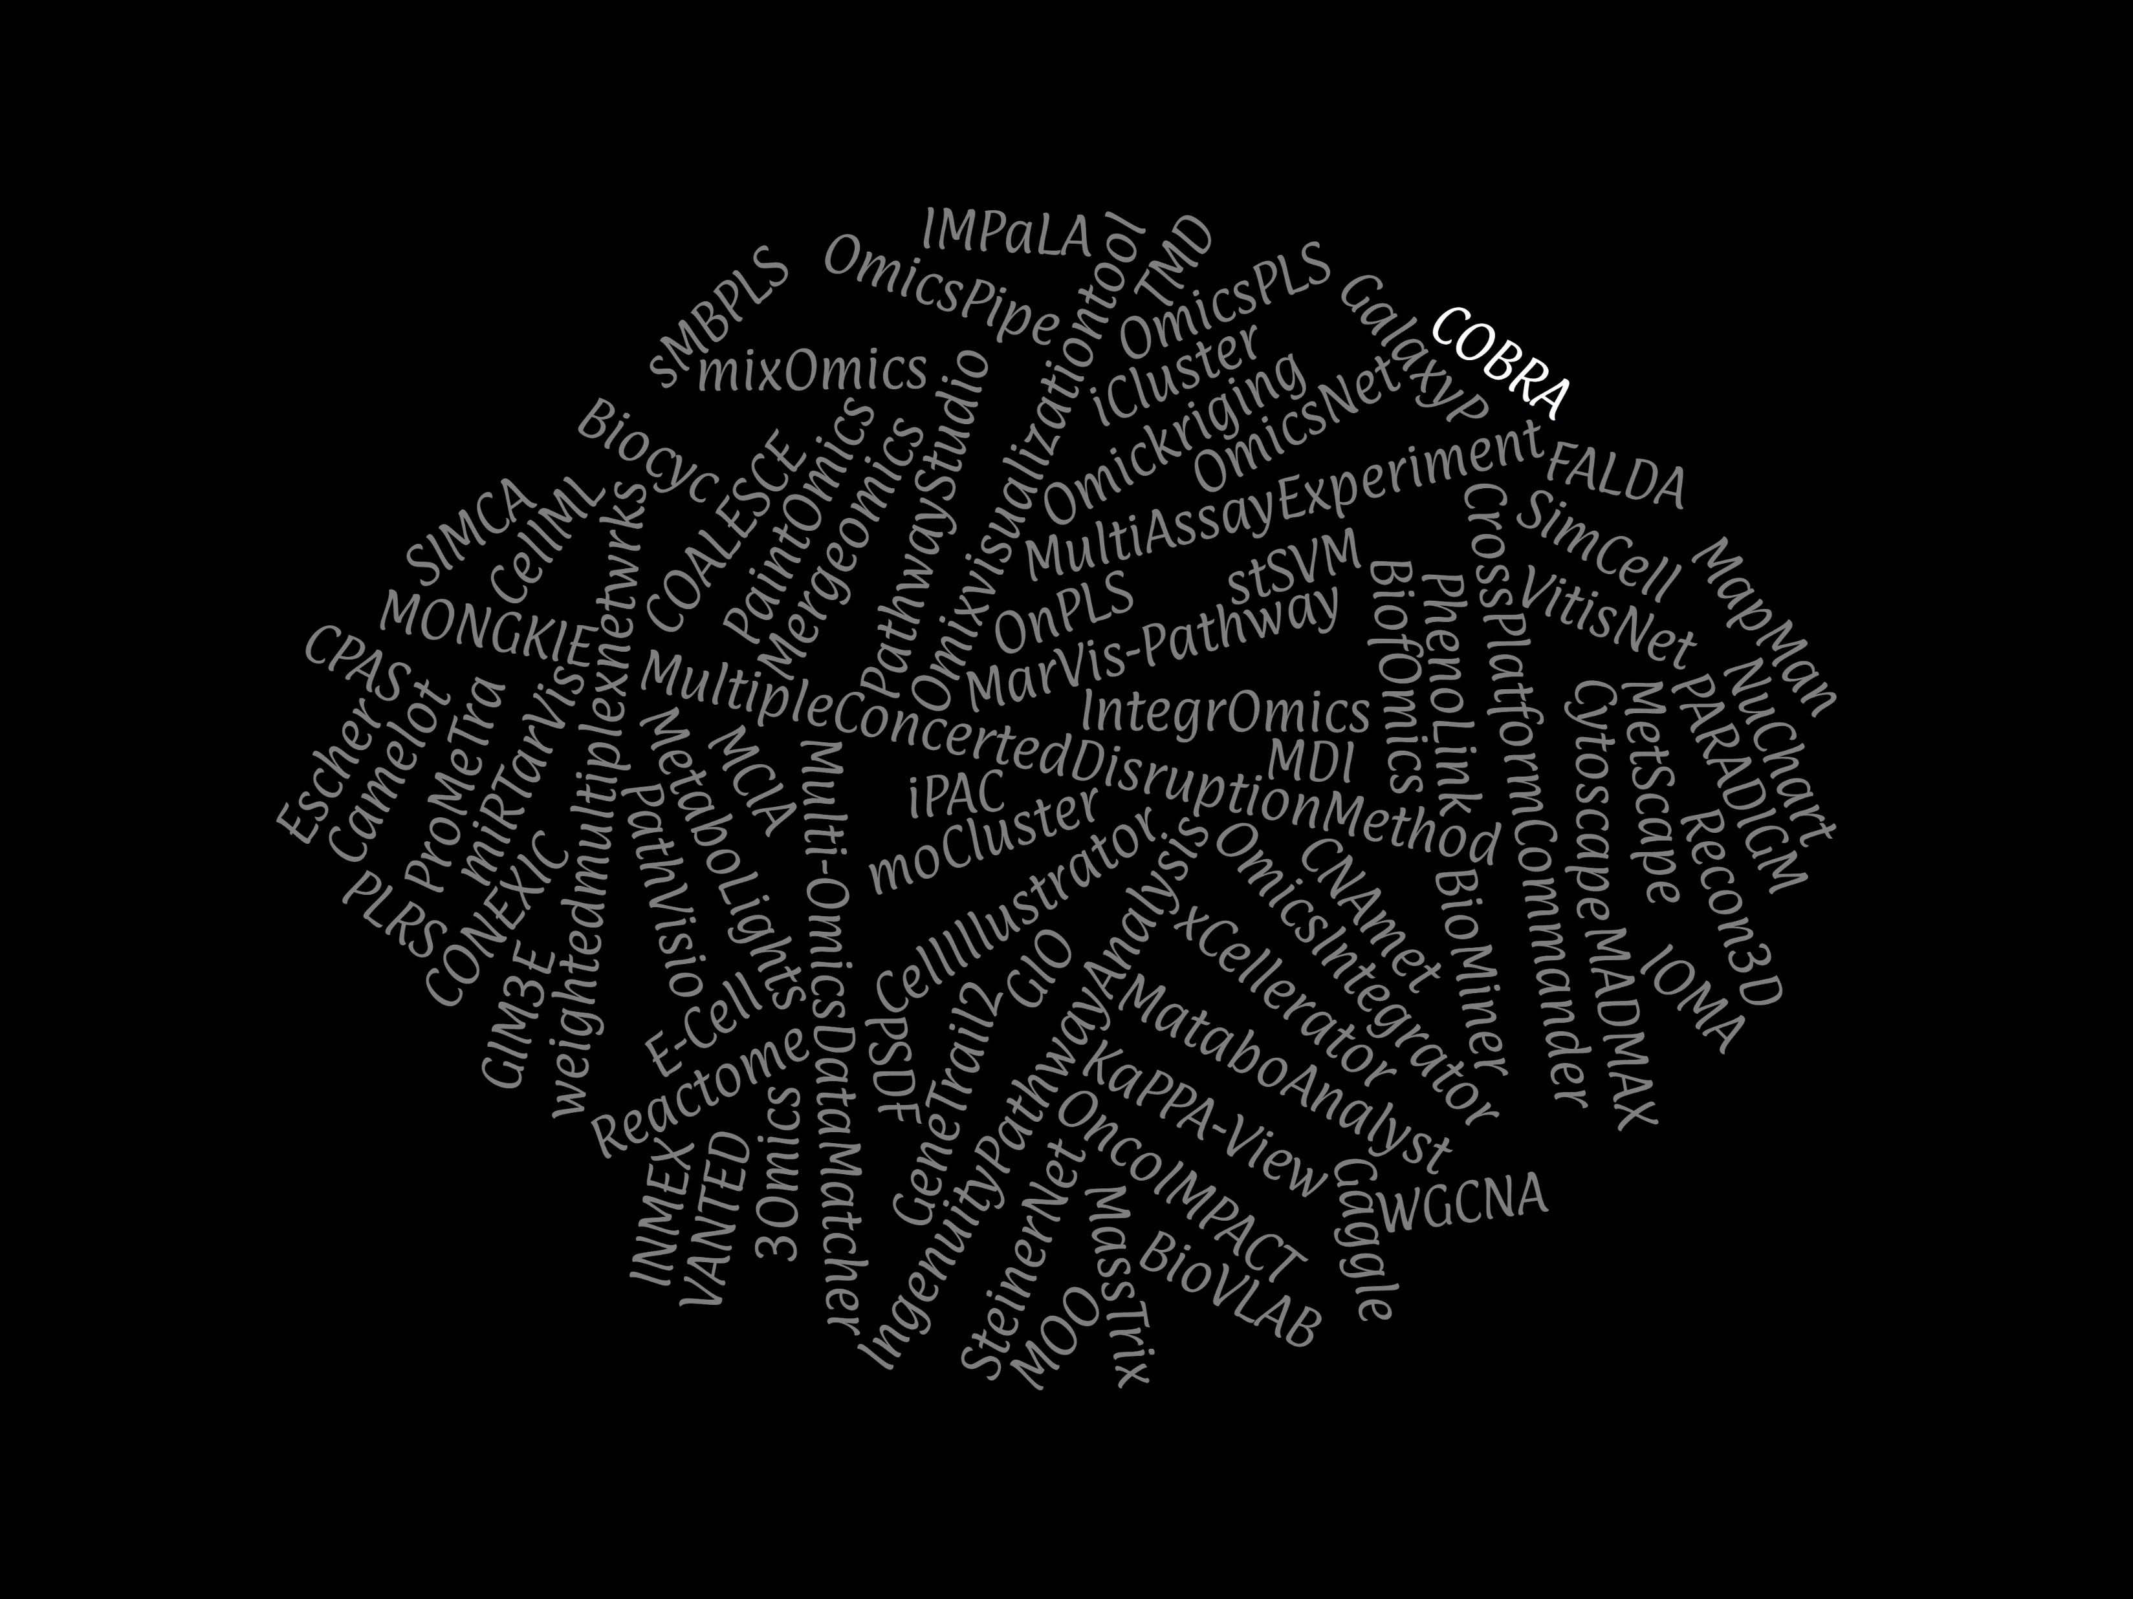

Slide 11
integration multi-omics data in yeast
visualization
import
normalization
integration
analysis
modeling

Slide 12
normalization integration and analysis
post-analysis integration
integrated analysis

Slide 13
analysis

Slide 14
visualization

Slide 15
modeling

